Slide 1
Collection Framework

Slide 2
Content
What is Collection?
Need of Collection
Collection Framework
Collection Hierarchy
Collection implementations
List
Set
Map
Cursors

Slide 3
What is Collection?
If we want to represent a group of "individual objects" as a single entity then we should go for collection.
In general we can consider collection as root interface of entire collection framework.
Collection interface defines the most common methods which can be applicable for any collection object.
There is no concrete class which implements Collection interface directly.

Slide 4
Need of Collection
Limitation of Array:
An array is an indexed collection of fixed number of homogeneous data elements.
An array represents a group of elements of same data type.
To use arrays concept compulsory we should know the size in advance which may not possible always.
Example:
int[] s=new int[10000];
s[0]=1;//valid
s[1]=“ABC”;//invalid(compile time error)

Slide 5
To overcome the array limitations we should go for collections concept.
Collections are growable in nature that is based on our requirement we can increase (or) decrease the size hence memory point of view collections concept is recommended to use.
Collections can hold both homogeneous and heterogeneous objects.
Every collection class is implemented based on some standard data structure hence for every requirement ready-made method support is available being a programmer we can use these methods directly without writing the functionality on our own.

Slide 6
Differences between Arrays and Collections
Array | Collection
Arrays are fixed in size. | Collections are growable in nature.
Memory point of view arrays are not recommended to use. | Memory point of view collections are highly recommended to use.
Arrays can hold only homogeneous data type elements. | Collections can hold both homogeneous and heterogeneous elements.
There is no underlying data structure for arrays and hence there is no read made method support. | Every collection class is implemented based on some standard data structure and hence readymade method support is available.
Arrays can hold both primitives and object types. | Collections can hold only objects but not primitives.

Slide 7
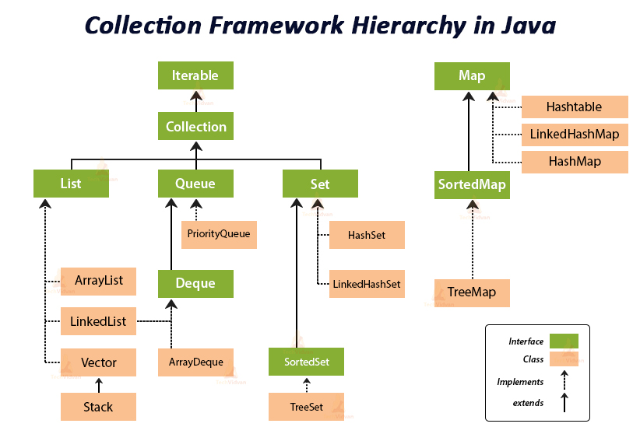
Collection Framework Hierarchy

Slide 8
List Interface
It is the child interface of Collection. If we want to represent a group of individual objects as a single entity where duplicates are allow and insertion order is preserved. Then we should go for List.
We can differentiate duplicate objects and we can maintain insertion order by means of index hence "index play very important role in List".
List interface defines the following specific methods.
boolean add(int index,Object o);
boolean addAll(int index,Collection c);
Object get(int index);
Object remove(int index);
Object set(int index,Object new);//to replace
Int indexOf(Object o);
Int lastIndexOf(Object o);
ListIterator listIterator();

Slide 9
ArrayList
The underlying data structure is resizable array (or) growable array.
Duplicate objects are allowed.
Insertion order preserved.
Null insertion is possible.
Constructors:
ArrayList a=new ArrayList();
Creates an empty ArrayList object with default initial capacity "10" if ArrayList reaches its max capacity then a new ArrayList object will be created with
New capacity=(current capacity*3/2)+1
ArrayList a=new ArrayList(int initialcapacity);
Creates an equivalent ArrayList object for the given Collection that is this constructor meant for inter conversation between collection objects.
ArrayList a=new ArrayList(collection c);

Slide 10
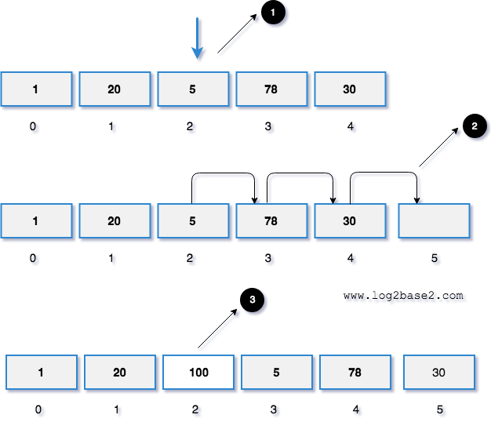
Insertion deletion in the middle ArrayList has O(n) time complexity for arbitrary indices of add/remove, but O(1) for the operation at the end of the list.

Slide 11
LinkedList
The underlying data structure is double LinkedList
Duplicate objects are allowed, Insertion order is preserved Null insertion is possible.
Constructors:
LinkedList l=new LinkedList(); //Creates an empty LinkedList object.
LinkedList l=new LinkedList(Collection c); //To create an equivalent LinkedList object for the given collection.
Usually we can use LinkedList to implement Stacks and Queues. To provide support for this requirement LinkedList class defines the following 6 specific methods.
1. void addFirst(Object o);
2. void addLast(Object o);
3. Object getFirst();
4. Object getLast();
5. Object removeFirst();
6. Object removeLast();

Slide 12
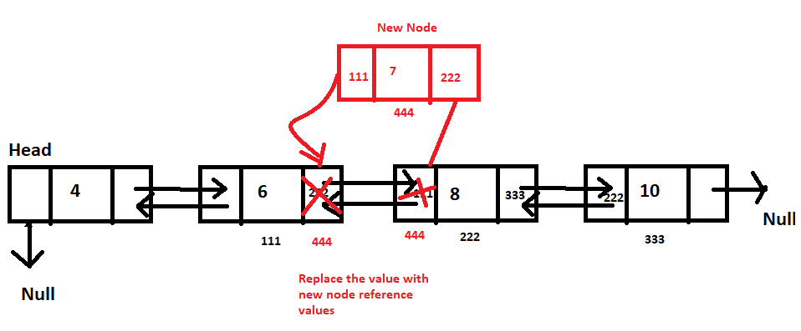
Insertion deletion in the middle Doubly-linked list, the time complexity for inserting and deleting an element is O(1) and O(n) for search

Slide 13
Difference between ArrayList and LinkedList
ArrayList | LinkedList
ArrayList internally uses a dynamic array to store the elements. | LinkedList internally uses a doubly linked list to store the elements.
If our frequent operation is retrieval operation then ArrayList is best choice. | If our frequent operation is insertion (or) deletion in the middle then LinkedList is the best choice.
Manipulation with ArrayList is slow because it internally uses an array. If any element is removed from the array, all the bits are shifted in memory. | Manipulation with LinkedList is faster than ArrayList because it uses a doubly linked list, so no bit shifting is required in memory.
This class implements a List interface. Therefore, this acts as a list. | This class implements both the List interface and the Deque interface. Therefore, it can act as a list and a deque.

Slide 14
Set Interface
It is the child interface of Collection.
If we want to represent a group of individual objects as single entity "where duplicates are not allow and insertion order is not preserved" then we should go for Set interface.
Set interface does not provide any get() method like the List interface to retrieve elements. Therefore, the only way to take out elements from the set can be by using Iterator() method.

Slide 15
HashSet
The underlying data structure is Hashtable.
Insertion order is not preserved and it is based on hash code of the objects.
Duplicate objects are not allowed.
If we are trying to insert duplicate objects we won't get compile time error and runtime error add() method simply returns false.
Null insertion is possible.(only once).
Constructors:
HashSet h=new HashSet();
Creates an empty HashSet object with default initial capacity 16 and default fill ratio 0.75(fill ratio is also known as load factor).
HashSet h=new HashSet(int initialcapacity);
HashSet h=new HashSet(int initialcapacity,float fillratio);
4. HashSet h=new HashSet(Collection c);
Note : After filling how much ratio new HashSet object will be created , The ratio is called "FillRatio" or "LoadFactor".

Slide 16
TreeSet
The underlying data structure is balanced tree.
Duplicate objects are not allowed.
Insertion order is not preserved and it is based on some sorting order of objects(ascending).
Heterogeneous objects are not allowed if we are trying to insert heterogeneous objects then we will get ClassCastException.
Null insertion is not possible.
Constructors:
TreeSet t=new TreeSet();
Creates an empty TreeSet object where all elements will be inserted according to default natural sorting order.
TreeSet t=new TreeSet(Comparator c);
Creates an empty TreeSet object where all objects will be inserted according to customized sorting order specified by Comparator object.
TreeSet t=new TreeSet(SortedSet s);
TreeSet t=new TreeSet(Collection c);

Slide 17
Map Interface
If we want to represent a group of objects as "key-value" pair then we should go for Map interface.
Duplicate keys are not allowed but values can be duplicated
Each key-value pair is called "one entry".
Map interface is not child interface of Collection and hence we can't apply Collection interface methods here.
Map interface defines the following specific methods.
Object put(Object key,Object value);
void putAll(Map m);
Object get(Object key);
Object remove(Object key);
boolean containsKey(Object key);
boolean containsValue(Object value);
Set keySet();
Collection values();
Set entrySet();

Slide 18
HashMap
The underlying data structure is Hashtable.
Duplicate keys are not allowed but values can be duplicated.
Insertion order is not preserved and it is based on hash code of the keys.
Null is allowed for keys(only once) and for values(any number of times)
Constructors:
1. HashMap m=new HashMap();
Creates an empty HashMap object with default initial capacity 16 and default fill ratio "0.75".
2. HashMap m=new HashMap(int initialcapacity);
3. HashMap m =new HashMap(int initialcapacity, float fillratio);
4. HashMap m=new HashMap(Map m);

Slide 19
Difference between HashMap and Hashtable
HashMap | Hashtable
No method is synchronized. | Every method is synchronized.
Multiple Threads can operate simultaneously on HashMap object and hence it is not Thread safe. | Multiple Threads can't operate simultaneously on Hashtable object and hence Hashtable object is Thread safe.
Relatively performance is high. | Relatively performance is low.
Null is allowed for both key and value. | Null is not allowed for both key and value otherwise we will get NullPointerException.
It is non legacy and introduced in 1.2v. | It is legacy and introduced in 1.0v.

Slide 20
TreeMap
The underlying data structure is RED-BLACK Tree.
Duplicate keys are not allowed but values can be duplicated.
Insertion order is not preserved and all entries will be inserted according to some sorting order of keys.
If we are depending on default natural sorting order keys should be homogeneous and Comparable otherwise we will get ClassCastException.
If we are defining our own sorting order by Comparator then keys can be heterogeneous and non Comparable.
There are no restrictions on values they can be heterogeneous and non Comparable.
We will get NullPointerException ig try to add null key.
There are no restrictions for null values.
Constructors:
1. TreeMap t=new TreeMap(); //For default natural sorting order.
2. TreeMap t=new TreeMap(Comparator c); //For customized sorting order.
3. TreeMap t=new TreeMap(SortedMap m);
4. TreeMap t=new TreeMap(Map m);

Slide 21
The 3 cursors of java
If we want to get objects one by one from the collection then we should go for cursor.
There are 3 types of cursors available in java. They are:
1. Enumeration
2. Iterator
3. ListIteratorEnumeration:
We can use Enumeration to get objects one by one from the legacy collection objects. We can create Enumeration object by using elements() method.
public Enumeration elements();
Enumeration e=v.elements();
using Vector Object Enumeration interface defines the following two methods
1. public boolean hasMoreElements();
2. public Object nextElement();

Slide 22
Iterator
Iterator:
1. We can use Iterator to get objects one by one from any collection object.
2. We can apply Iterator concept for any collection object and it is a universal cursor.
3. While iterating the objects by Iterator we can perform both read and remove operations.
We can get Iterator object by using iterator() method of Collection interface.
public Iterator iterator();
Iterator itr=c.iterator();
Iterator interface defines the following 3 methods.
1. public boolean hasNext();
2. public object next();
3. public void remove();

Slide 23
ListIterator
ListIterator:
ListIterator is the child interface of Iterator. By using listIterator we can move either to the forward direction (or) to the backward direction that is it is a bi-directional cursor.
While iterating by listIterator we can perform replacement and addition of new objects in addition to read and remove operations .By using listIterator method we can create listIterator object.
public ListIterator listIterator();
ListIterator itr=l.listIterator();
ListIterator interface defines the following 9 methods.
1. public boolean hasNext();
2. public Object next(); forward
3. public int nextIndex();
4. public boolean hasPrevious();
5. public Object previous(); backward
6. public int previousIndex();
7. public void remove();
8. public void set(Object new);
9. public void add(Object new);

Slide 24
Compression of Enumeration Iterator and ListIterator ?
Property | Enumeration | Iterator | ListIterator
Is it legacy ? | Yes | no | no
It is applicable for ? | Only legacy classes. | Applicable for any collection object. | Applicable for only list objects.
Moment? | Single direction cursor(forward) | Single direction cursor(forward) | Bi-directional.
How to get it? | By using elements() method. | By using iterator()method. | By using listIterator() method.
Accessibility? | Only read. | Both read and remove. | Read/remove/replace/add.
Methods | hasMoreElement() nextElement() | hasNext() next() remove() | 9 methods.

